Slide 1
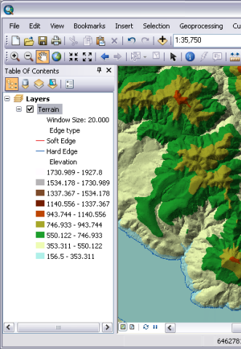
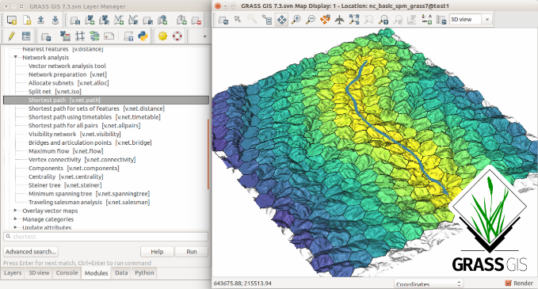
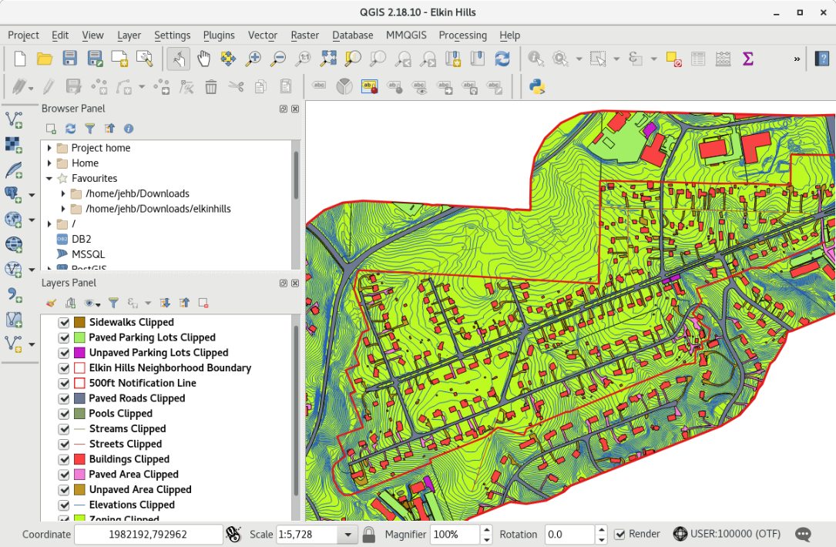
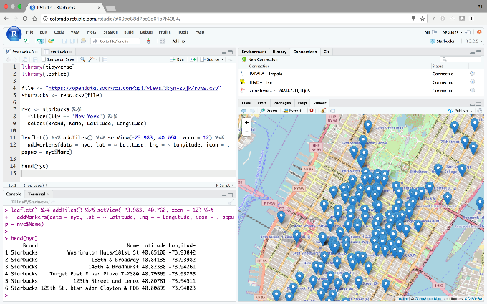
Open source alternatives to ESRI products

Slide 2
Alternatives to ArcGIS and ArcPro
Many open-source GIS programs and analytical tools
Key distinction:
1) Stand-along GIS applications, and
2) Analytical tools that ALSO have GIS/mapping capabilities
While dozens exists, there are 4 far superior choices:
QGIS
GRASS GIS
R Maptools
Carto

Slide 3

Alternatives #1 - QGIS
Open-source GIS – runs on Linux, Unix, Mac, and windows
Supports numerous vector, raster, and database formats
Great documentation and active user community
Tons of plug-ins adding functionality
Has python interface
Easiest transition from Arc
Clean interface
Easy to use

Slide 4
Alternatives #1 – QGIS vs ArcGIS
Features and functionality | ArcGIS | QGIS
Versatility in consuming all different types of data |  | X
Simplicity and ease of use | X | X
Explore your geodata with ArcCatalog or QGIS Browser | X
Ease of joining tabular and spatial data | X | X
Ability to handle and on-the-fly map projections | X | X
Base maps and other readily available GIS data | X
License levels |  | X
Variety of specialized tools | X
Raster processing capabilities | X | X
Geostatistical analysis and help documentation | X
Remote sensing analysis tools |  | X
Routing analysis tools | X
Model building and reproducibility | X
All purpose mapping | X | X
3D analyses and mapping | X
Web mapping (story maps) | X
Documentation and helpful examples | X

Slide 5
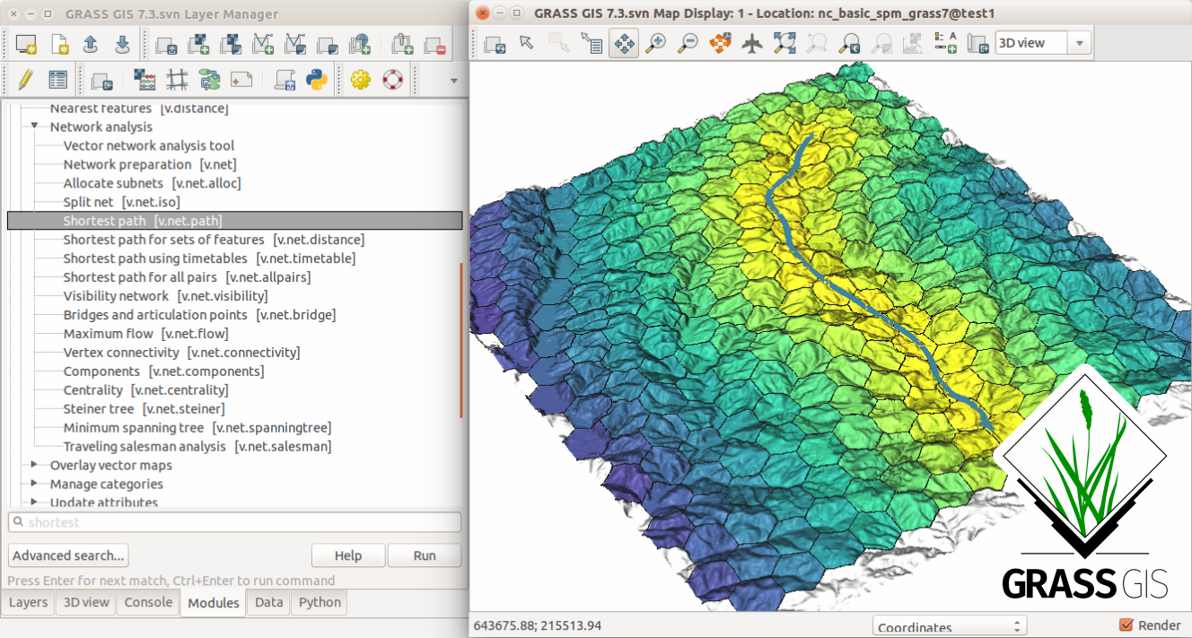
Alternatives #2 – GRASS
Graphical Resources Analysis Support System (GRASS)
Open-source GIS – runs on Linux, Unix, Mac, and windows
Developed in 82’ by US Government
Now maintained by academic community
GRASS HUB North America @ NC State University
Great for individuals with strong python skillset.
H20 analyses very good
Mapping and visualizations
less so…

Slide 6

Alternatives #3 – RStudio
Very easy to install and use
Open-source GIS – runs on Linux, Unix, Mac, and windows
Supports vector, raster, and database formats
Good documentation, active user community, and online resources available
Clean interface to visualize data
Computationally slow
Difficult to work with large raster products
No map based viewer to evaluate results
All done through plotting

Slide 7
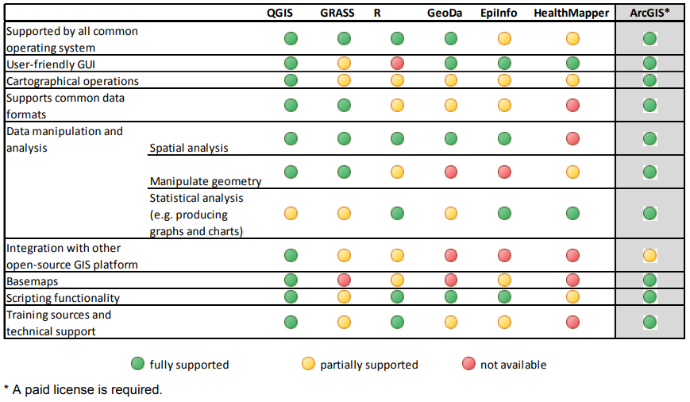
Wrapping up
ArcGIS has it all
Selecting other platforms should be based on needs and best fit

